Slide 1
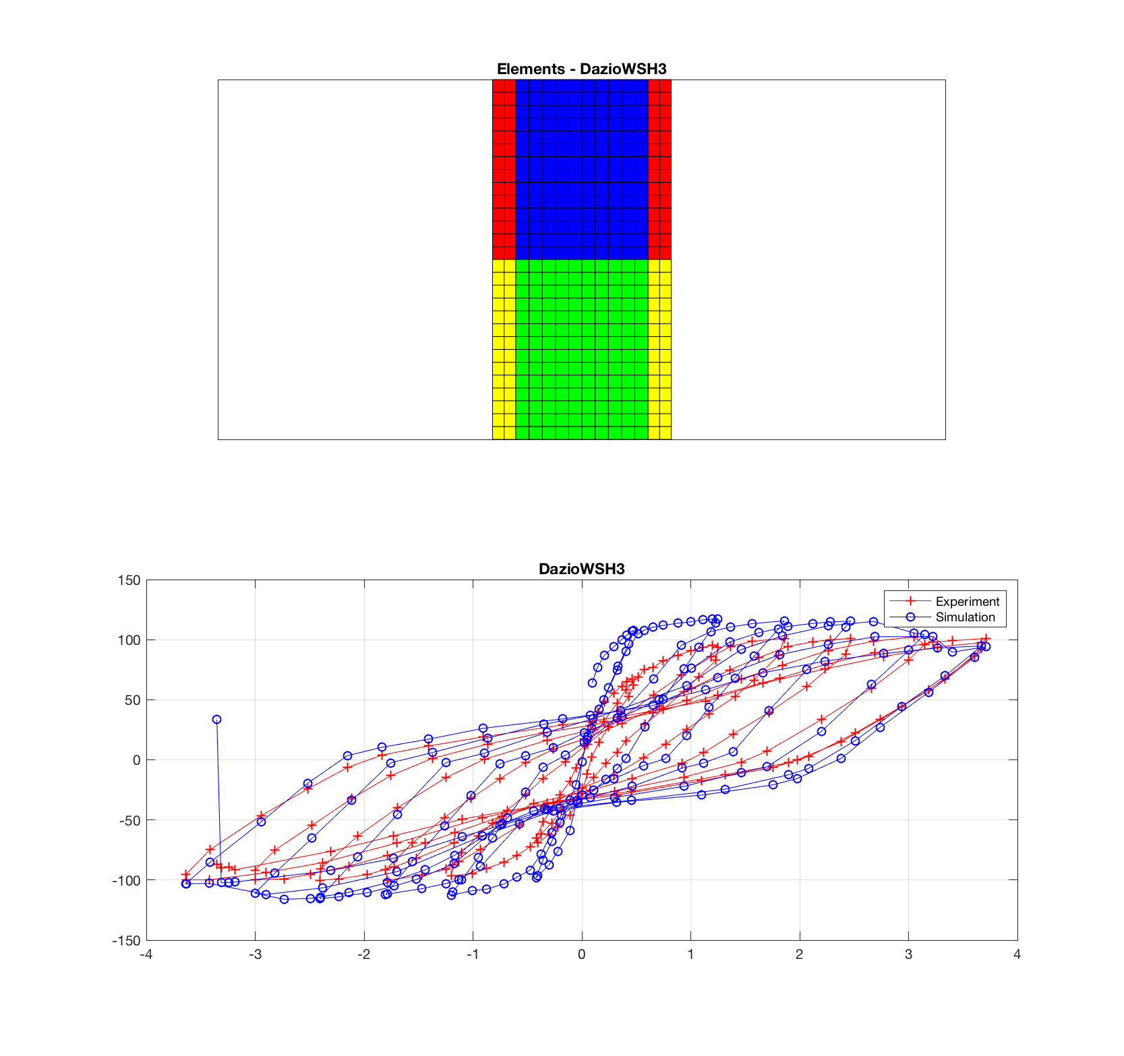
Element: quad (Continuum 2D )
http://opensees.berkeley.edu/wiki/index.php/Quad_Element
Material:nDMaterial PlasticDamageConcretePlaneStress
Faria R, Oliver J, Cervera M. A strain-based plastic viscous-damage model for massive concrete structures. International Journal of Solids and Structures 1998; 35(14):1533-1558.

Slide 2
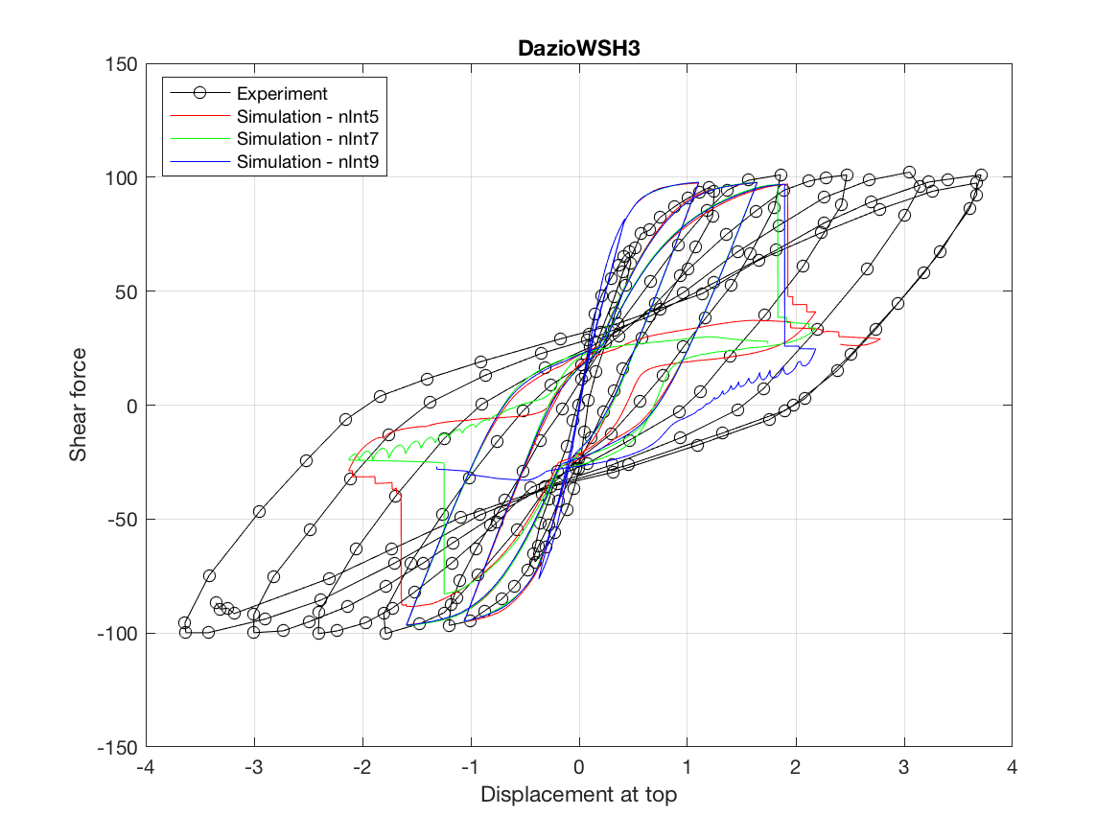
Element: forceBeamColumn (1D)
http://opensees.berkeley.edu/wiki/index.php/Force-Based_Beam-Column_Element
Material: uniaxialMaterial Steel01
http://opensees.berkeley.edu/wiki/index.php/Steel01_Material
uniaxialMaterial Steel02
http://opensees.berkeley.edu/wiki/index.php/Steel02_Material_--_Giuffr%C3%A9-Menegotto-Pinto_Model_with_Isotropic_Strain_Hardening
uniaxialMaterial Concrete02
http://opensees.berkeley.edu/wiki/index.php/Concrete02_Material_--_Linear_Tension_Softening

